Slide 1
HTTP Communication
Consuming REST Services
Lecture 1
By James(Jin) Wang
12/25/2021

Slide 2
Outline
Filtering a stream
Data stream vs. action stream
Subject and BehaviorSubject
Reacting to actions
Starting with an initial value

Slide 3
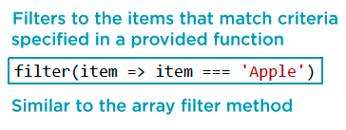
Filtering a stream
  RxJS Operator: filter

Slide 4
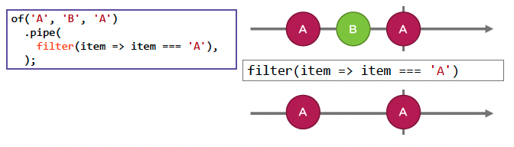
Filtering a stream
  Marble Diagram: filter

Slide 5
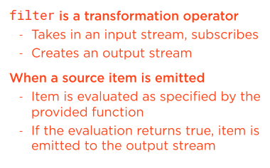
Filtering a stream
  RxJS Operator: filter
  Demo: filter hard-coded
  Demo: filter dropdown

Slide 6
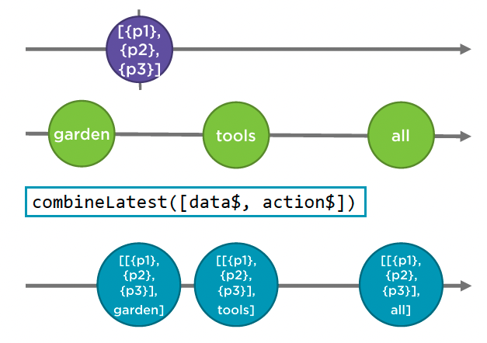
Data Stream vs. Action Stream

Slide 7
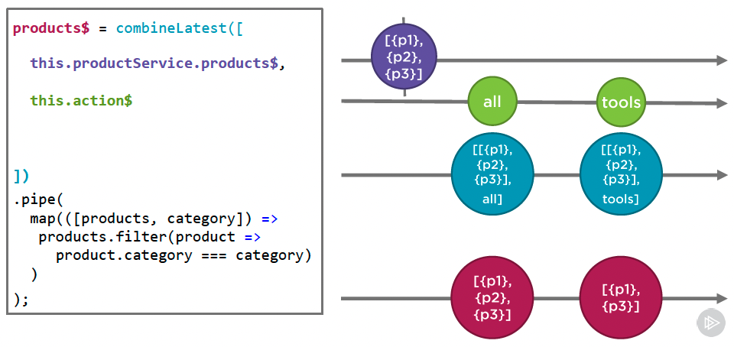
Data Stream vs. Action Stream

Slide 8
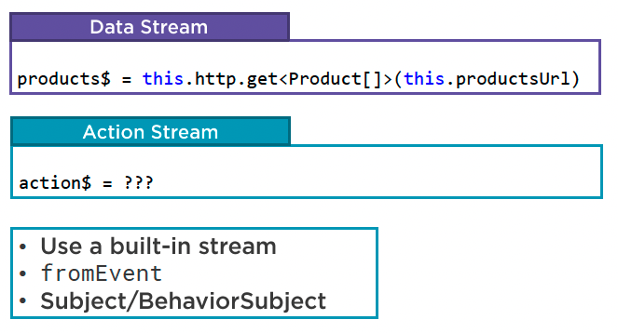
Data Stream vs. Action Stream
  Creating Streams

Slide 9
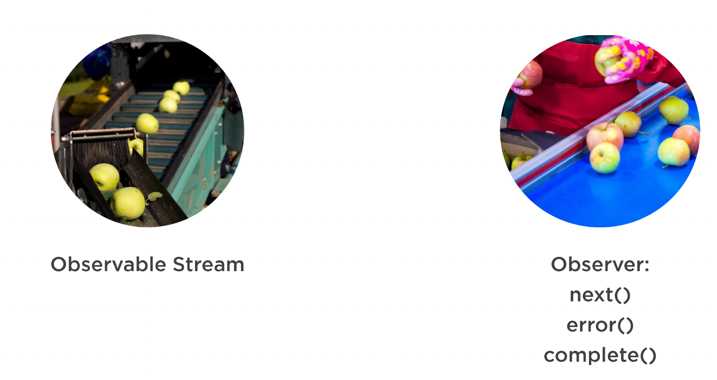
Subject and BehaviorSubject
  Observable and Observer

Slide 10
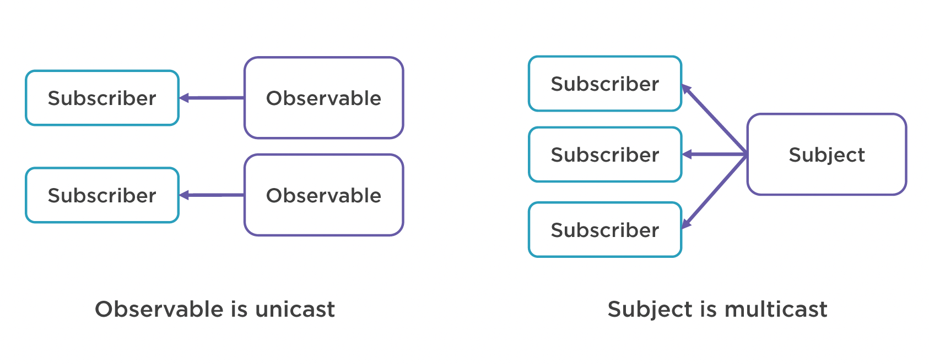
Subject and BehaviorSubject
  Unicast vs. Multicast

Slide 11
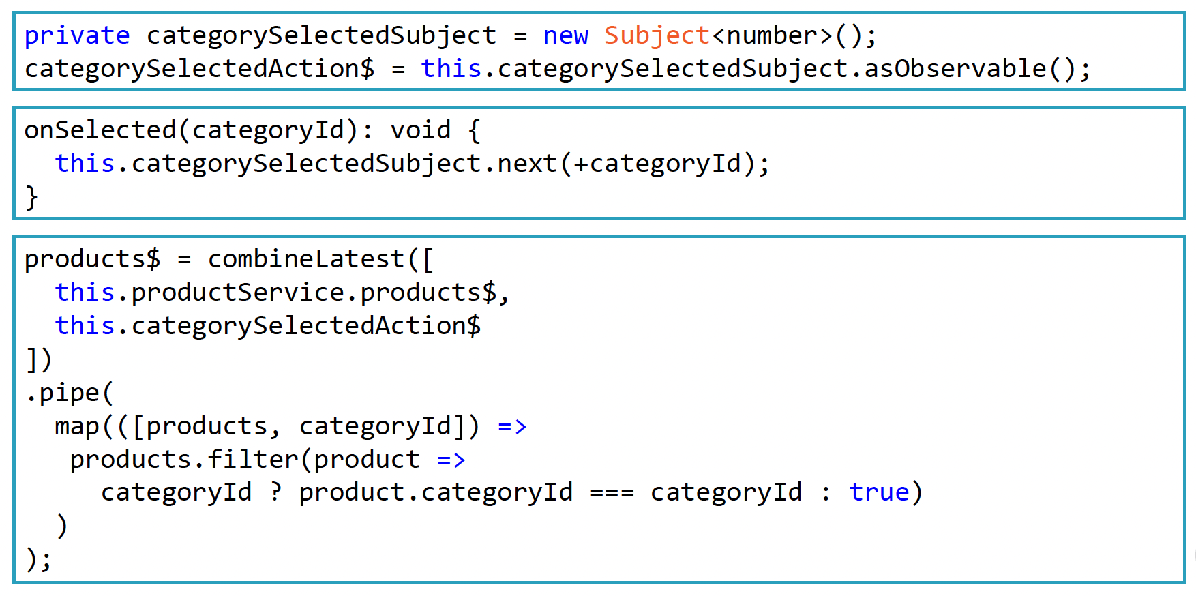
Subject and BehaviorSubject
  Subject

Slide 12
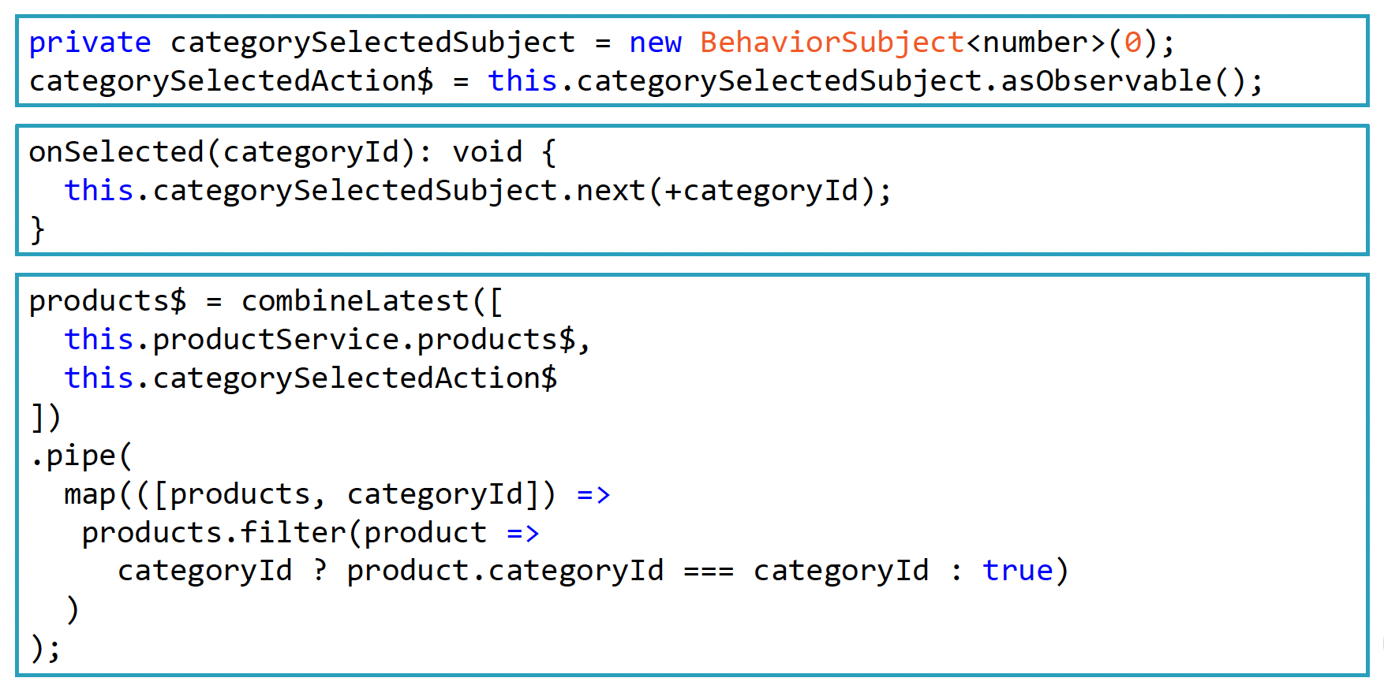
Subject and BehaviorSubject
  BehaviorSubject

Slide 13
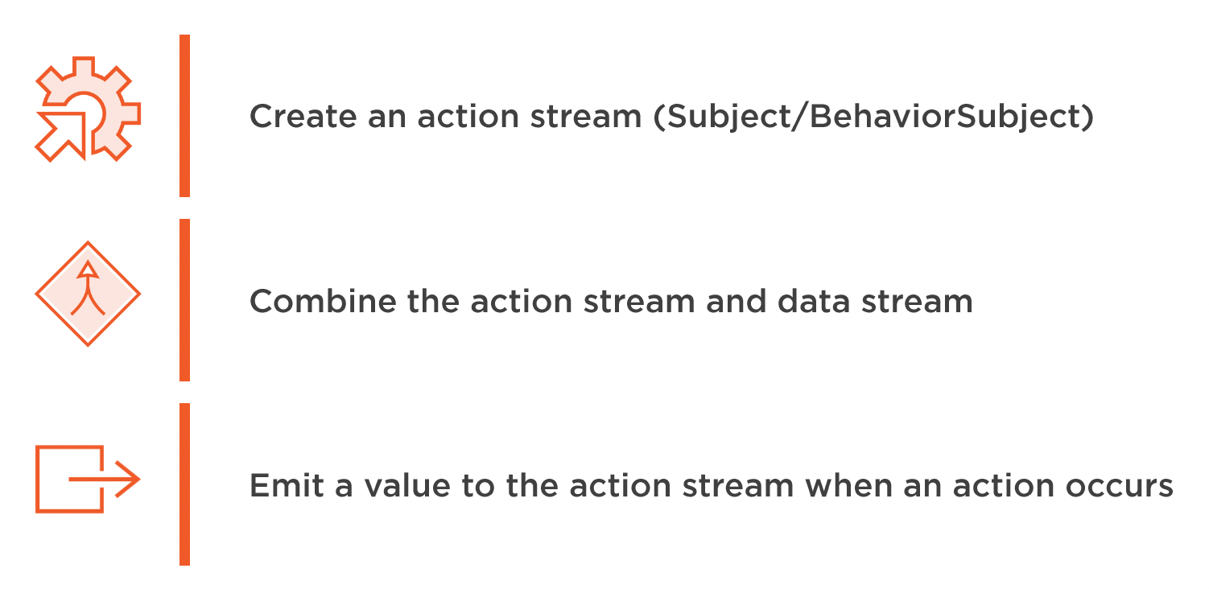
Reacting to Actions
  Demo: react to actions

Slide 14
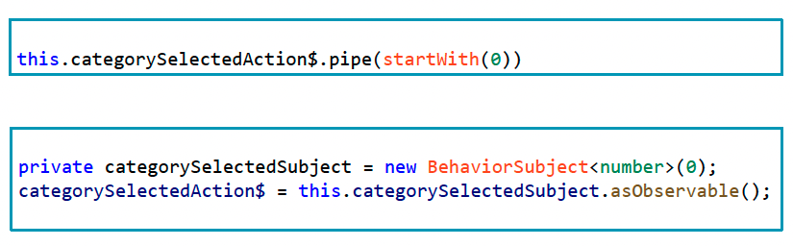
Start with an Initial Value

Slide 15
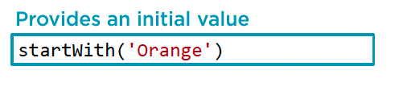
Start with an Initial Value
  RxJS Operator: startWith

Slide 16
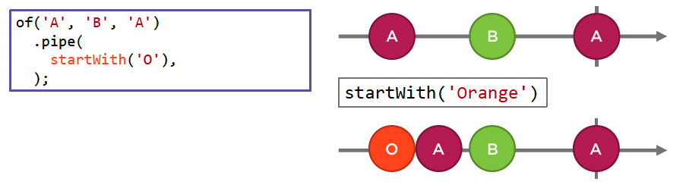
Start with an Initial Value
  Marble Diagram: startWith

Slide 17
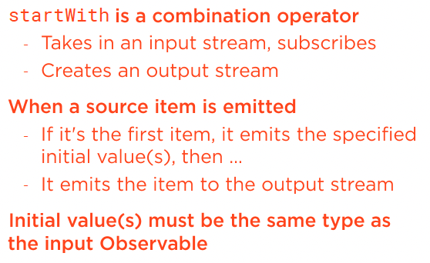
Start with an Initial Value
  RxJS Operator: startWith
  Demo: start with initial value

Slide 18
Summary

Slide 19
Assignment

Slide 20
Self Study
  RxJS: The Big Picture
  https://app.pluralsight.com/library/courses/rxjs-big-picture

